Slide 1
Homework
Week 9

Slide 2
Questions 1-7
36-2 = 34, C
2. C
3. 40L
4. D
5. Janice = 50c, 20c, 5 Jeremy = 50c, 50c, 50c
6. D
7. 5b-4 = 2b + 17
5b – 2b = 17 + 4
3b = 21
b = 7

Slide 3
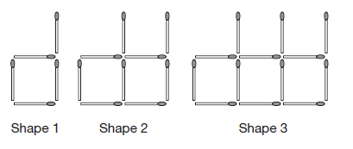
Question 8
Here are the first three shapes in a pattern made from matchsticks. How many matchsticks are needed to make the 12th shape in this pattern?
Shape Number: 1 2 3
Number of Sticks: 5 9 13 (adding 4 sticks each time, gradient = 4)
Number of sticks = 4 x shape number + 1
Sticks for 12th Shape = 4 x 12 + 1
= 49
ANSWER = 49 matchsticks

Slide 4
Question 9
A ticket costs $75. A fee of 10% is added to the price. Which calculation will give the new price?
75 + 10 75 + 0.1 75 x 0.1 75 x 1.1
Answer = D

Slide 5


Question 10
What is the value of x°?
Alternate angles are equal
Answer = 125°

Slide 6

Question 11
The area of this rectangle is 28mm². Find the length of the missing dimension ‘x’.
28 = 7x (÷ 7)
4 = x
Answer = 4 mm

Slide 7

Question 12
The distance from P to Q is four times the distance from Q to R. The distance from P to R is 120 metres. What is the distance from Q to R?
120 = 4QR +QR
120 = 5QR (÷ 5)
24 = QR
ANSWER = 24 m

Slide 8

Question 13
The rule to change temperatures in degrees Celsius (°C), to temperatures in degrees Fahrenheit (°F) is . The maximum temperature today was 35°C. What is this in degrees Fahrenheit?
Answer = 95°

Slide 9
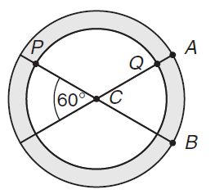
Question 14
This symbol is made from two circles and two lines. The circles have the same centre, C. The radius of the small circle is the radius of the large circle. The angle between the two lines is 60°. The arc AB is 16 mm. What is the length of the arc PQ in millimetres?
c = 60°
(which is double the size of c)
Inner Arc of AB = x 16
= 12mm
Arc PQ = 12 x 2
= 24 mm
Answer = 24 mm

